Slide 1
Simulation in a Hospital Emergency Department
Rachel Loo

Slide 2
Simulation results: Baseline Scenario
Total patients: 86
Simulation time: 24 hrs
Patient outcomes:
Discharged: 74 (86.0%)
Admitted: 12 (14.0%)
Average service times:
Fast track: 39.0 mins
Main ED: 168.1 mins
Average waiting times:
Nurse: 0.9 mins
Doctor: 9.6 mins
Average total patient times: 109.6 mins
Resource utilisation:
Fast track nurse: 27.1%
Fast track doctor: 60.4%
Main ED nurses: 18.8%
Main ED doctors: 68.8%
Main ED beds: 57.7%

Slide 3
Simulation results: High Patient Volume Scenario
Total patients: 102
Simulation time: 24 hrs
Patient outcomes:
Discharged: 87 (85.3%)
Admitted: 15 (14.7%)
Average service times:
Fast track: 39.1 mins
Main ED: 392.2 mins
Average waiting times:
Nurse: 1.2 mins
Doctor: 27.9 mins
Average total patient times: 239.9 mins
Resource utilisation:
Fast track nurse: 27.1%
Fast track doctor: 60.4%
Main ED nurses: 23.6%
Main ED doctors: 92.7%
Main ED beds: 90.8%

Slide 4
Simulation results: Improved Resources Scenario
Total patients: 80
Simulation time: 24 hrs
Patient outcomes:
Discharged: 69 (86.2%)
Admitted: 11 (13.8%)
Average service times:
Fast track: 49.2 mins
Main ED: 154.4 mins
Average waiting times:
Nurse: 1.5 mins
Doctor: 8.7 mins
Average total patient times: 103.1 mins
Resource utilisation:
Fast track nurse: 29.2%
Fast track doctor: 56.2%
Main ED nurses: 18.1%
Main ED doctors: 64.6%
Main ED beds: 49.6%

Slide 5
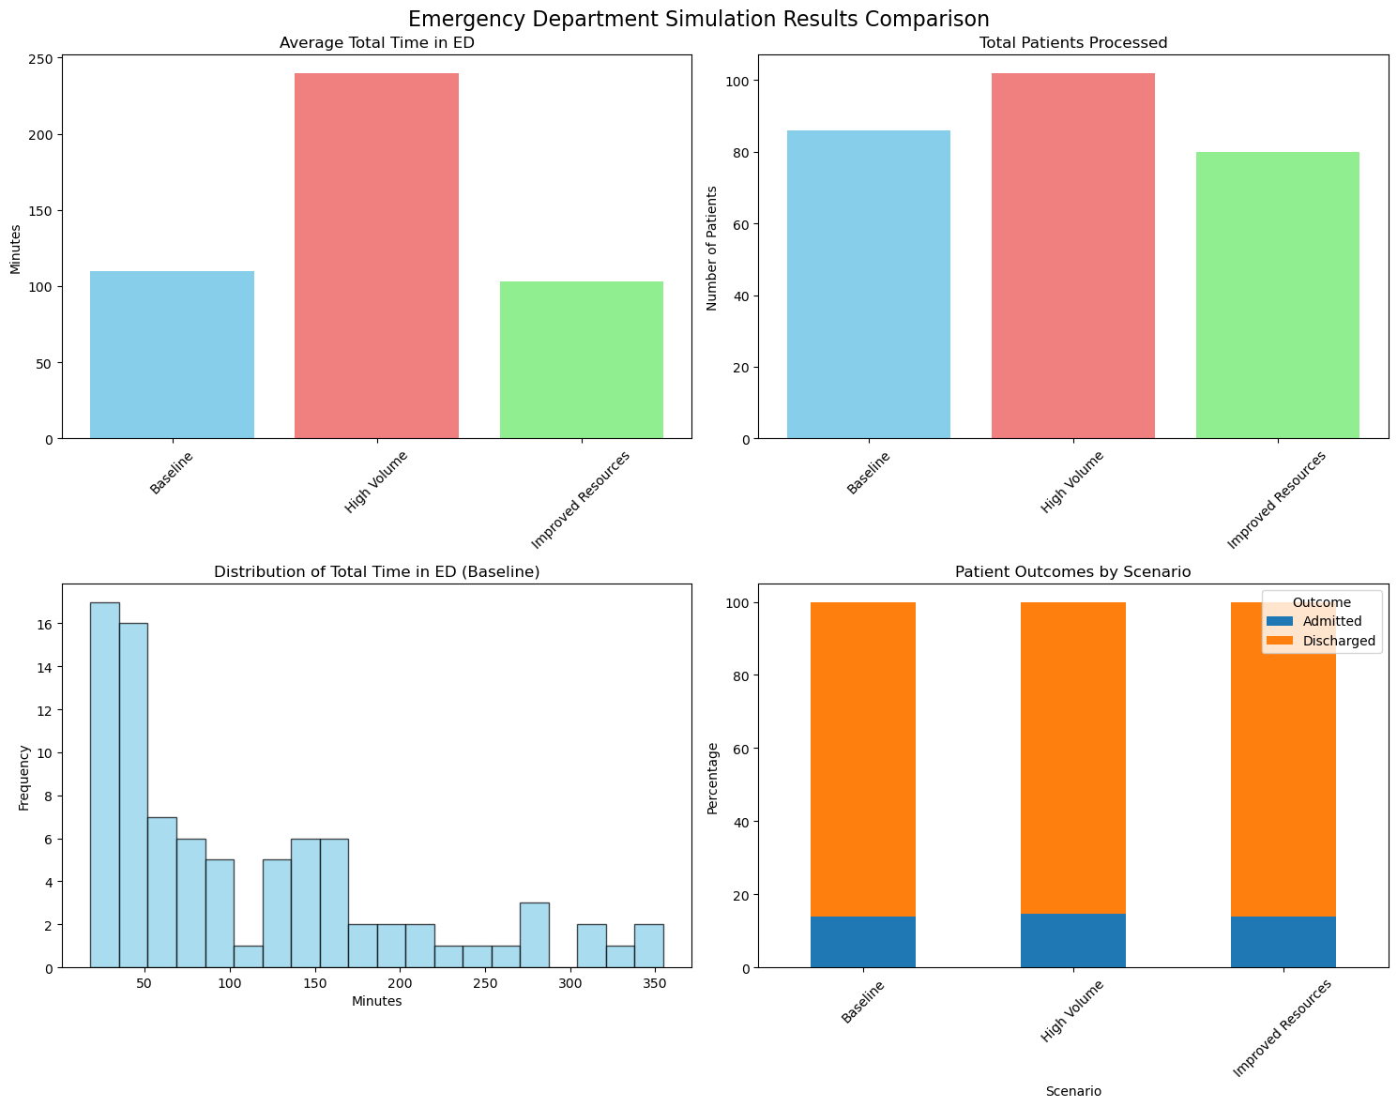
Simulation results Plots

Slide 6
Insights and Improvements
FAST TRACK PERFORMANCE:
Fast Track average time: 39.0 mins
Main ED average time: 168.1 mins
Fast Track utilisation: 45.3% of patients
SCENARIO COMPARISON:
IMPROVEMENTS:
Monitor queue lengths in real-time
Implement triage protocols to optimise Fast Track usage
Review staffing schedules during peak hours
Consider process improvements for laboratory turnaround times
Develop admission protocols to reduce ED boarding time
 | High Volume | Improved Resources
Average time change | -119.0% | +5.9%
Patients processed | 102 vs 86 (baseline) | 80 vs 86 (baseline)

Slide 7

Thank you
Rachel Loo | Rachel.loojiayin@gmail.com

